Slide 1
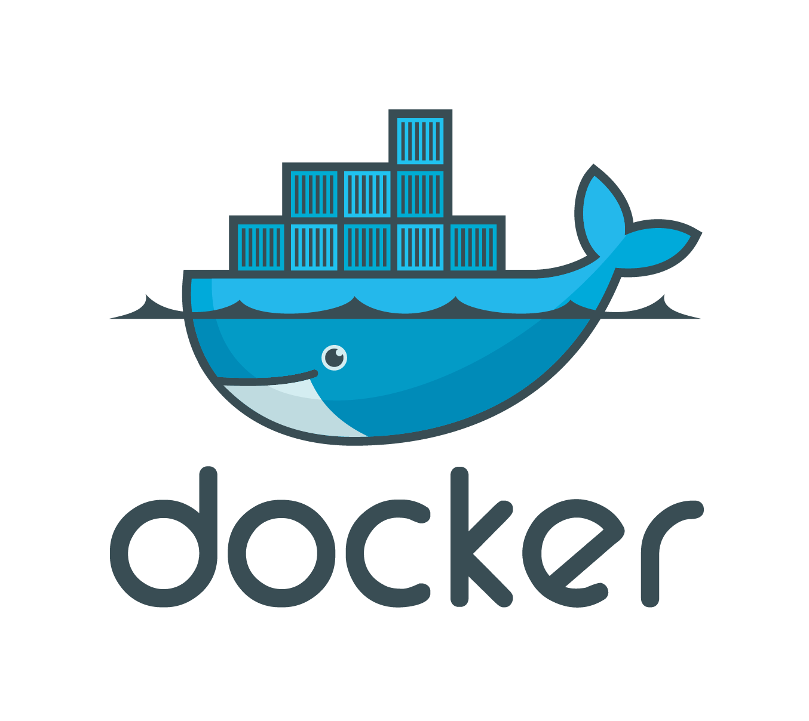

Slide 2
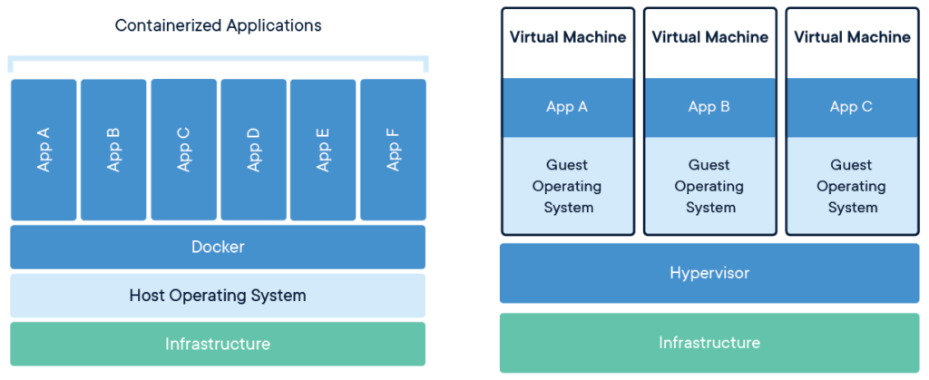
What is DOCKER
A tool that allows us to develop, deploy and run software in a container. With Docker we can package up the application with all libraries and dependencies, and unlike virtual machine they don’t require so much resources, so they are faster and more easy to use.

Slide 3
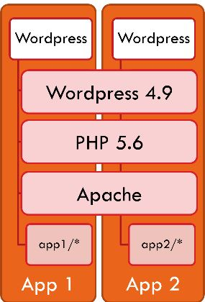
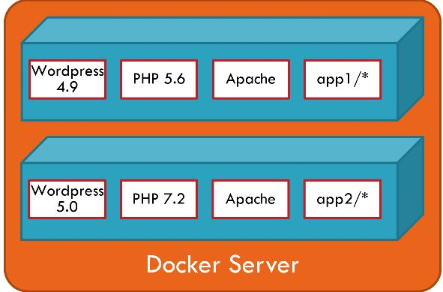
WHY DOCKER
It solves most of the challenges for DevOps teams
Easy to Update
Allows Easy Scaling Up

Slide 4
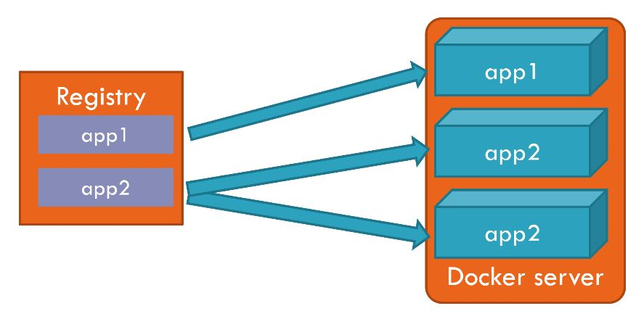
Basic Concepts
Containers
Images
Registries
Volumes

Slide 5
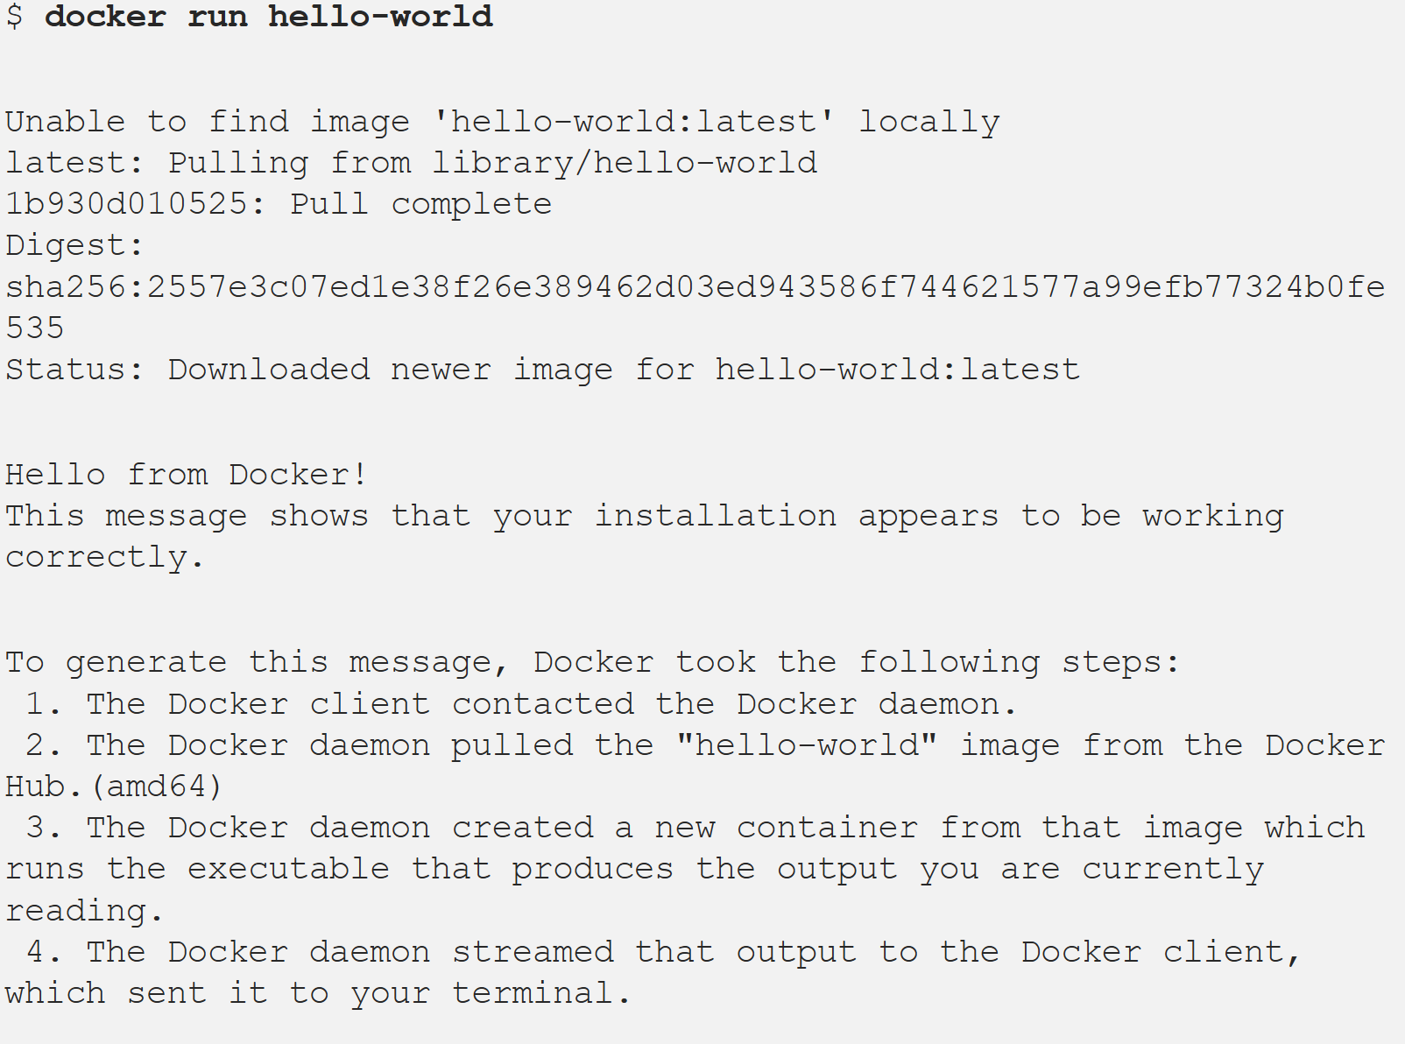
RUNNING FIRST CONTAINER
docker run hello-world .

Slide 6
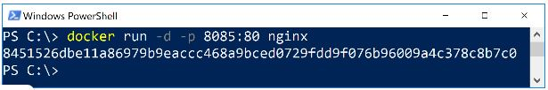
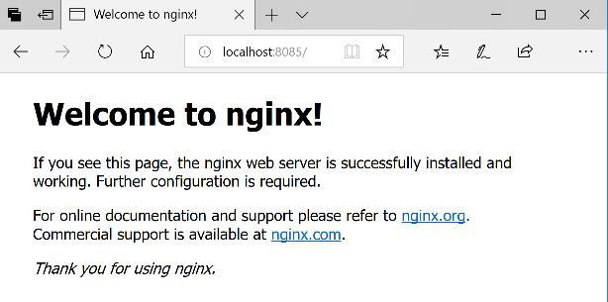
Running Server Containers
docker run -d -p 8085:80 nginx
docker run -p 8088:8080 jenkins

Slide 7
Container Mgmt Commands
docker ps <containerName or containerId>
docker logs <containerName or containerId>
docker inspect <containerName or containerId>
docker stop <containerName or containerId>
docker rm <containerName or containerId>
docker ps -a <containerName or containerId>
docker logs 48bab7f673b3

Slide 8
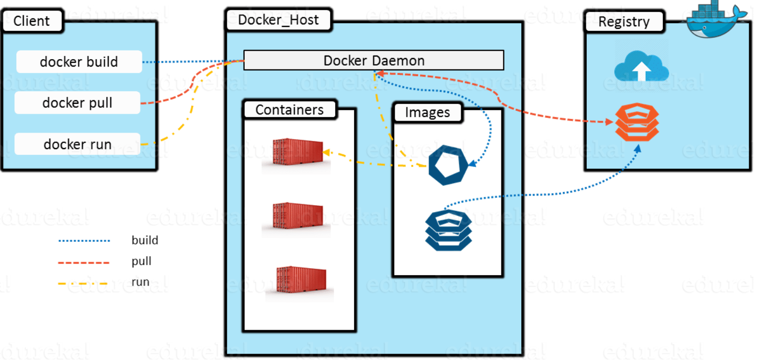
Sources of Images
docker run
Image locally present?use:registry;
repository_name>/<name>:<tag>
docker pull repository_name>/<name>:<tag>

Slide 9
Creating Images
DockerFile
FROM nginx:1.15
COPY index.html /usr/share/nginx/html
Build Image
docker build -t webserver .
Run the container
docker run --rm -it -p 8082:80 webserver
http://localhost:8082

Slide 10
Image Tags
<repository_name>/<name>:<tag>
Why Tags?
1.Roll back
2. Different versions in different environments (test and prod)
3. Canary release
4. Different versions to different users
→ docker build -t hello:1.0 .
Tags for Base Images
FROM nginx:latest

Slide 11
Storage & Networking
docker run -d mongo
docker run -v /your/dir:/data/db -d mongo
EXPOSE 80
docker run --rm -it -p 8082:80 webserver

Slide 12
Publishing Images
Motive?
docker build <short_name>/<name>:<tag>
docker login -u <userId> -p <your-password>
docker push <short_name>/<name>:<tag>
Run an Image on Another Machine (If Public)
docker run --rm -it -p 8085:80 <short_name>/<name>:<tag>
http://localhost:8085

Slide 13
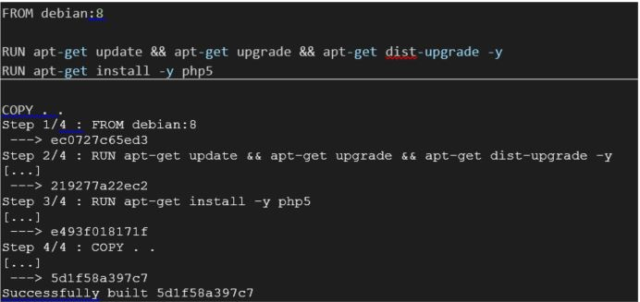
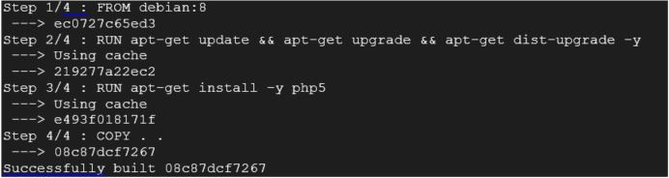
Image Size
Why it Matters?
Base Image Size
Image Layers
FROM debian:8
RUN apt-get update && apt-get upgrade && apt-get dist-upgrade -y
RUN apt-get install -y php5
COPY . .

Slide 14
Orchestration
Kubernetes or Docker Swarm
spec:
replicas: 10
spec:
containers:
- image: learnbook/aspnetcore-server:1.2
ports:
- containerPort: 80
env:
- name: ASPNETCORE_ENVIRONMENT
value: "Release"

Slide 15
Thank You

